Slide 1

Vel Tech Rangarajan Dr. Sagunthala R&D Institute of Science and Technology
School of Computing
Department of Computer Science and Engineering
10211CS224 / FULL STACK APPLICATION DEVELOPMENT (JAVA)
PROJECT REVIEW - 2
Date: 20-04-2026
Tech Fest 2026 – Online Event Ticket Booking System
SDG: SDG 8: Decent Work and Economic Growth
Presented By:
B.Venkata Reddy – VTU25671– 23UECS0099
Courses Handling Faculty:
Dr. Hafizur Rahman- B.E., M.Tech., Ph.D.

Slide 2
INTRODUCTION
Traditional event coordination often suffers from manual booking errors and data inconsistencies.
EventHub provides a centralized digital platform to automate ticketing and resource management.
This project is crucial for enhancing transparency and reducing administrative overhead for organizers
.
It features a modern Spring Boot backend synchronized with a high-performance React frontend.
The system offers real-world relevance through its application in festivals, seminars, and workshops.
A dynamic seat mapping engine ensures efficient venue utilization and prevents overbooking.
Advanced Admin Dashboards provide real-time insights into event performance and ticket sales.
Overall, it serves as a comprehensive solution for modern, secure, and streamlined event management.
1
2
3
4
5
6
7
8
9

Slide 3
PROBLEM STATEMENT
Currently, many event management processes are still handled using manual methods or siloed spreadsheets
This leads to inconsistencies in attendee data and significant delays in ticket processing.
Organizers lack real-time visibility into ticket sales and event metrics across the platform.
Fragmented systems make it difficult for users to discover and book diverse events seamlessly.
There is a high risk of ticket duplication and fraud without a centralized digital verification system.
Communication between organizers and attendees regarding event updates is often slow and inefficient.
Therefore, a reliable, automated, and centralized system is needed to improve overall performance and accuracy.
1
2
3
4
5
6
7
8
9

Slide 4
OBJECTIVE(S)
1
To design and develop a centralized ticketing platform called "Tech Fest 2026" that automates event discovery and booking.
To implement a dynamic seat management system that ensures real-time availability and prevents overbooking.
2
3
4
5
6
7
8
9

Slide 5
PROPOSED SYSTEM
Description: A full-stack web application leveraging Spring Boot for the backend and React for a modern, responsive frontend.
Real-time Booking: Users can instantly browse available events and purchase tickets with live updates.
Automated Seat Mapping: Implements a dynamic grid system (A, B... AA, AB) that handles varying venue capacities.
Admin Dashboard: Provides powerful management tools for organizers to track sales and monitor attendee lists.
Centralized Database: Uses H2/SQL to maintain a single source of truth for all events and transaction records.
Secure Authentication: Features role-based access control to distinguish between attendees and administrators.
Seamless UI/UX: Designed for a "premium" feel with smooth transitions, dark mode, and mobile-responsive layouts.
Scalability: The modular architecture allows for the easy addition of new features and event categories.
1
2
3
4
5
6
7
8
9

Slide 6
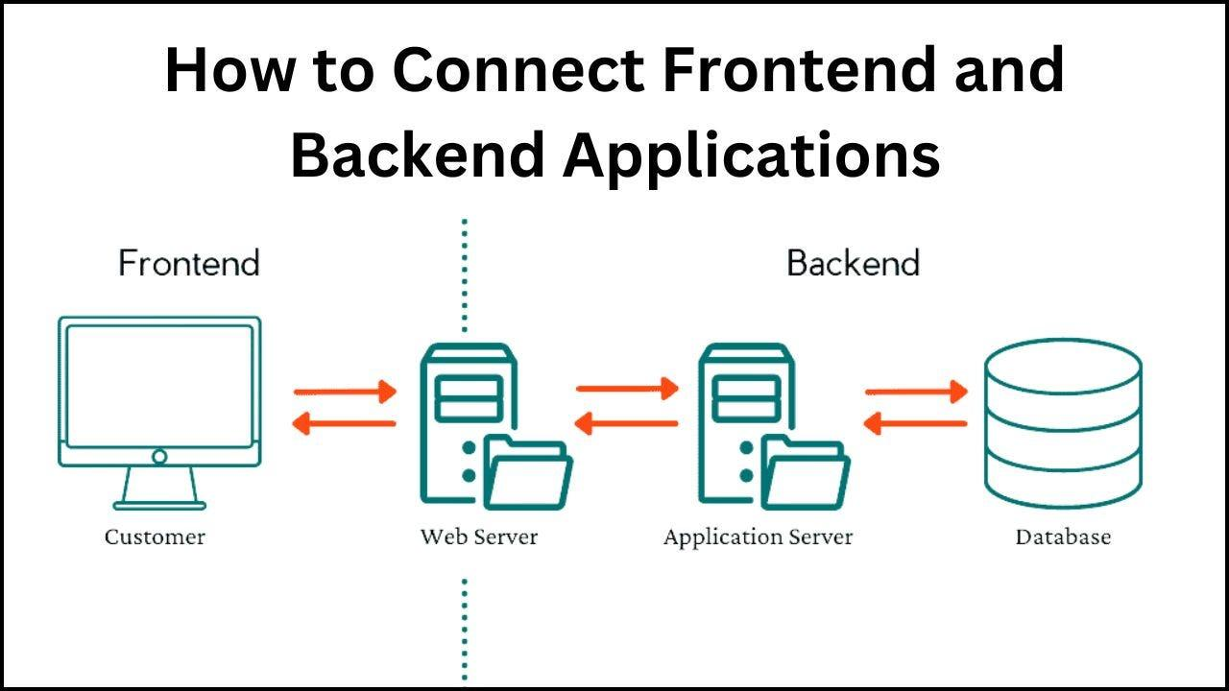
PROPOSED SYSTEM ARCHITECTURE
1
2
3
4
5
6
7
8
9

Slide 7
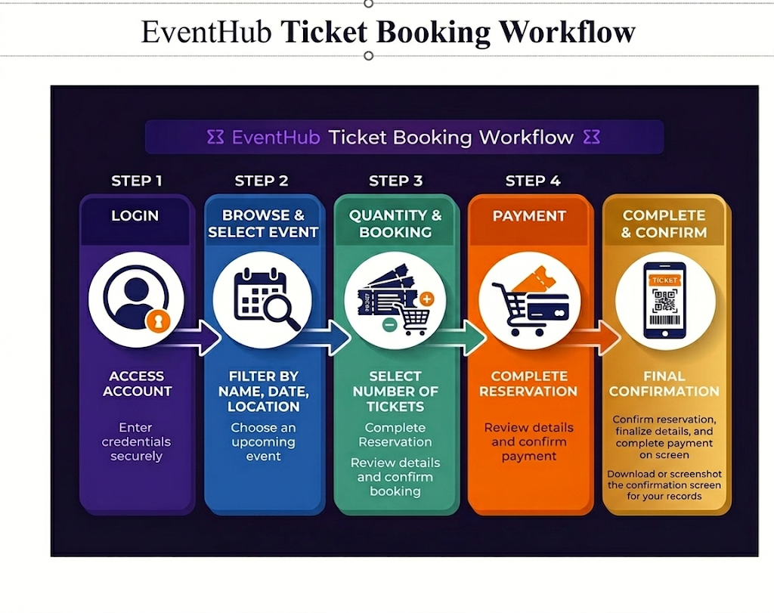
WORKFLOW
1
2
3
4
5
6
7
8
9

Slide 8
TECHNOLOGIES USED
1
Frontend: React.js (v19), Tailwind CSS.
Backend: Java 17, Spring Boot 3.4.0, Maven, Spring Data JPA (Hibernate).
Database: H2 (High-performance, in-memory/file-based relational database).
Tools: VS Code (IDE), ECLIPSE.
Software Requirements: Windows 10/11, Node.js v20+, Java JDK 17, Modern Web Browser.
Hardware Requirements: 8GB RAM minimum, Intel Core i5 Processor or equivalent, 500MB Free Disk Space.
2
3
4
5
6
7
8
9

Slide 9
MODULE DESCRIPTION
1
2
3
Module 1: User Authentication & Profiles: Handles secure user registration and login, maintaining persistent sessions and distinguishing between regular users and administrative staff.
Module 2: Event Discovery & Grid Management: Implements the dynamic event showcase and the advanced seat selection engine featuring robust, automated row labeling.
Module 3: Transactional Booking Engine: Manages the core business logic for ticket reservations, ensuring real-time seat synchronization and preventing overbooking in the database.
Module 4: Admin Management Console: A dedicated module for platform administrators to create events, update ticket capacities, and monitor global booking statistics.
4
5
6
7
8
9

Slide 10
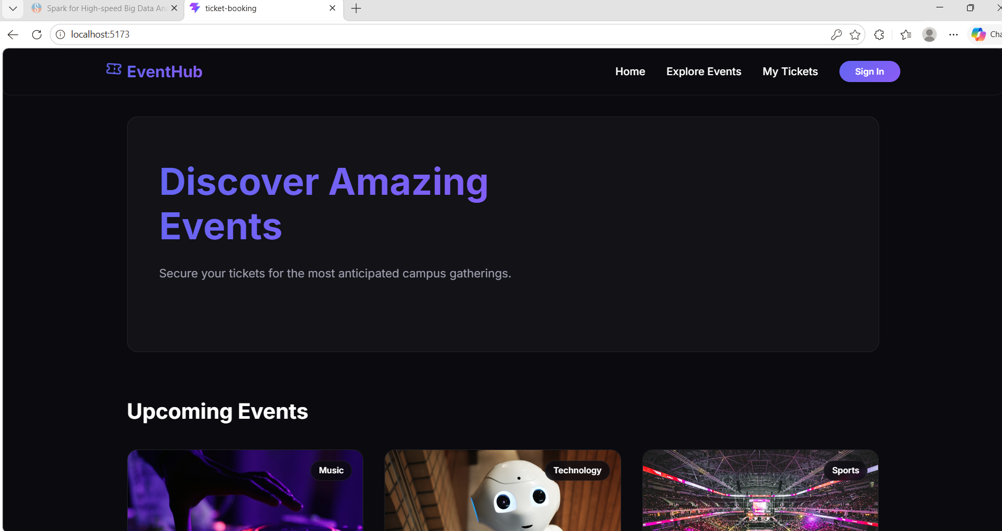
IMPLEMENTATION SCREENSHOTS
1
2
3
4
5
6
7
8
9
A sleek Tech Fest 2026 homepage showcasing upcoming campus events with a modern dark-themed interface and vibrant visuals. The platform highlights categories like Music, Technology, and Sports, making ticket booking simple and engaging.

Slide 11
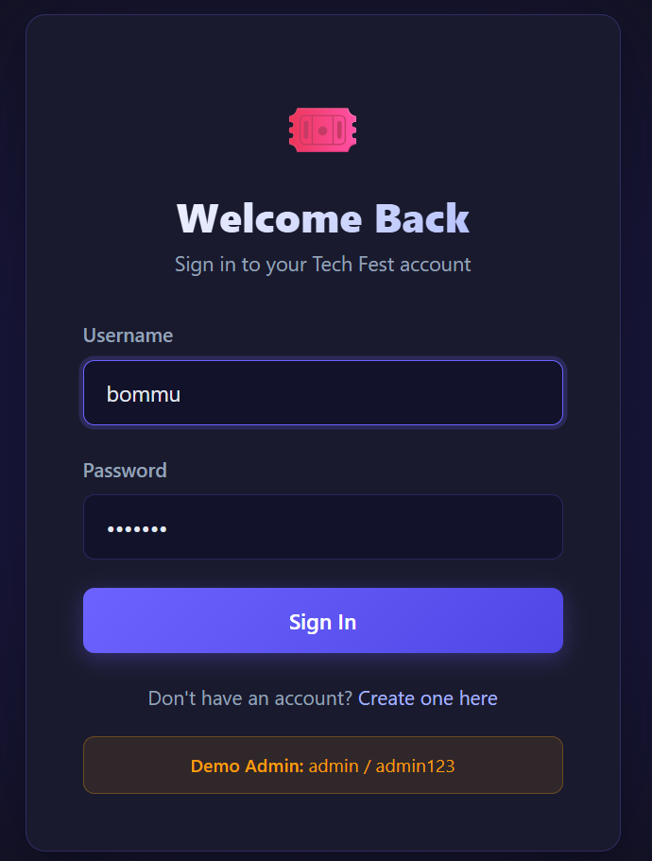
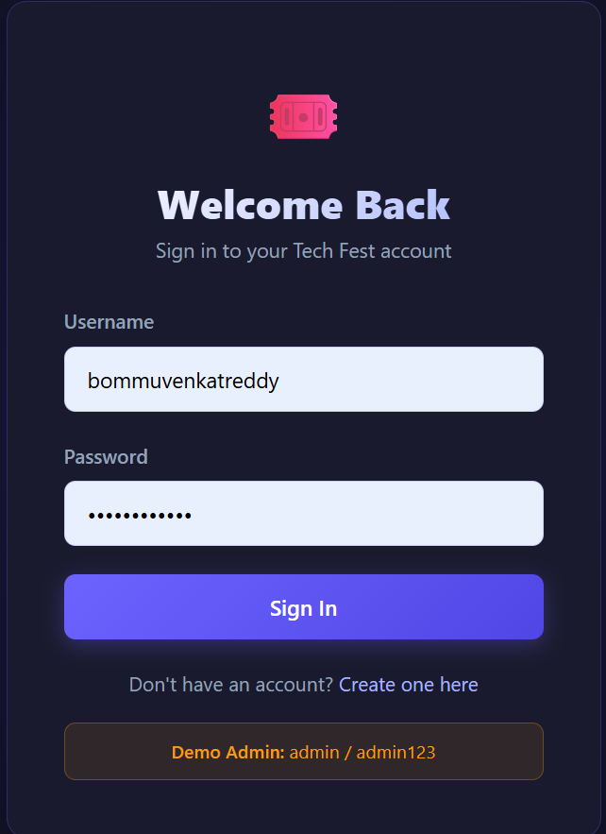
IMPLEMENTATION SCREENSHOTS
1
2
3
4
5
6
7
8(A)
9
A secure and modern admin login portal for Tech Fest 2026, designed with a sleek dark theme and authentication interface. It enables administrators to manage events, user bookings, and platform operations through a centralized control center.

Slide 12
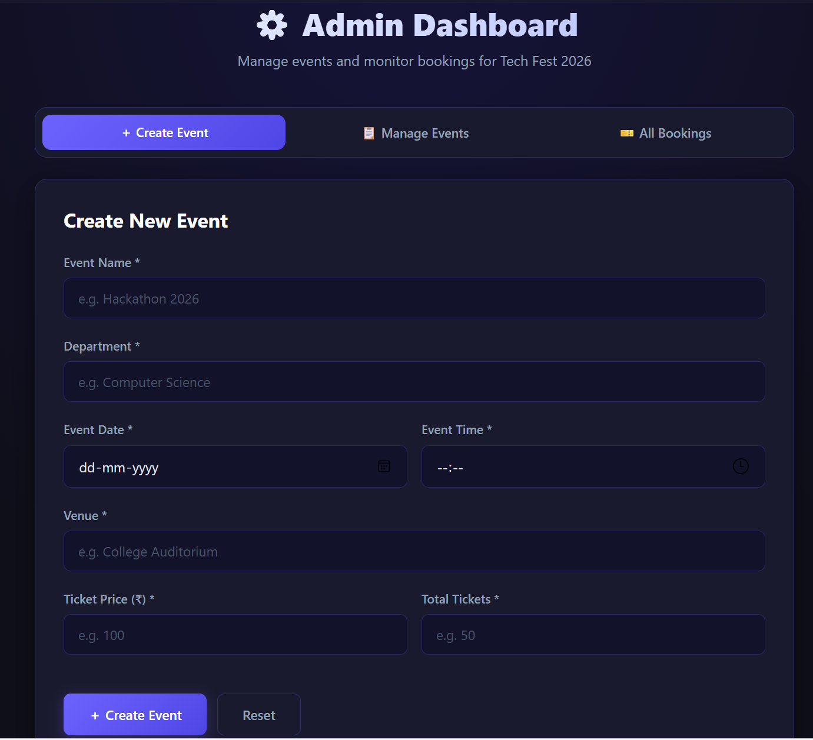
IMPLEMENTATION SCREENSHOTS
1
2
3
4
5
6
7
8(B)
9
A dynamic Tech Fest 2026 admin dashboard that allows organizers to add, manage, and monitor campus events efficiently. It features event creation forms and a real-time active events panel for seamless administration.

Slide 13

IMPLEMENTATION SCREENSHOTS
1
2
3
4
5
6
7
8(C)
9
An interactive Tech Fest 2026 ticket booking page displaying event details, seat selection, and user registration in a modern interface. Users can choose available seats, enter booking information, and confirm tickets seamlessly for live events.

Slide 14
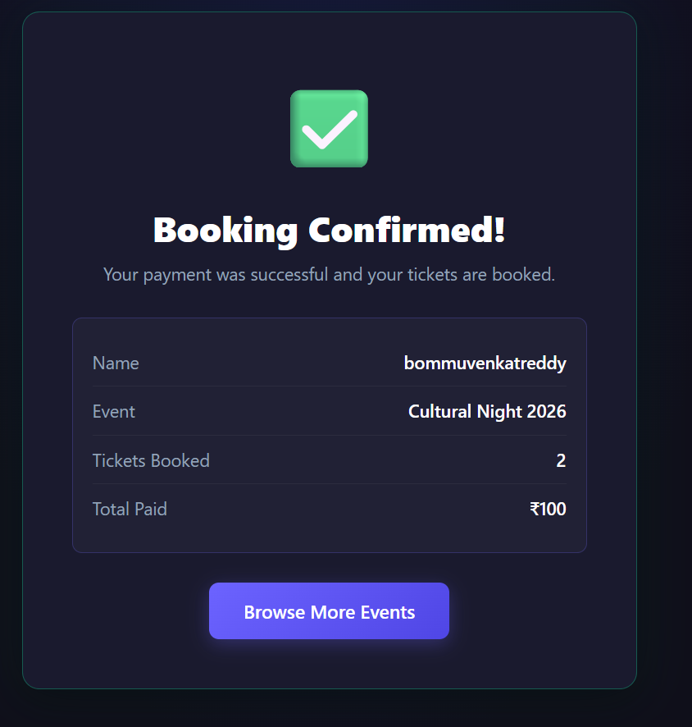
IMPLEMENTATION SCREENSHOTS
1
2
3
4
5
6
7
A live backend bookings dashboard displaying real-time ticket reservations, user details, event names, and payment totals. It helps administrators track bookings efficiently and monitor platform transactions instantly.
8(D)
9

Slide 15
ADVANTAGES & LIMITATIONS
1
ADVANTAGES
Complete Automation
Real-time Synchronization
Enhanced User Experience
Centralized Data Management
High Scalability
Transparency and Trust
DISADVANTAGES (LIMITATIONS)
Internet Dependency
Infrastructure Requirements
Local Storage Limitations
Payment Gateway Complexity
Technical Maintenance
Learning Curve.
2
3
4
5
6
7
8
9

Slide 16
Thank you

